Slide 1
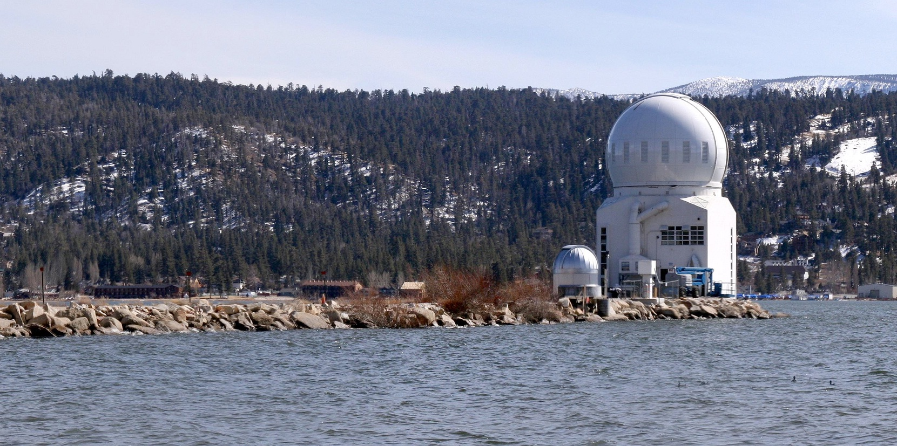
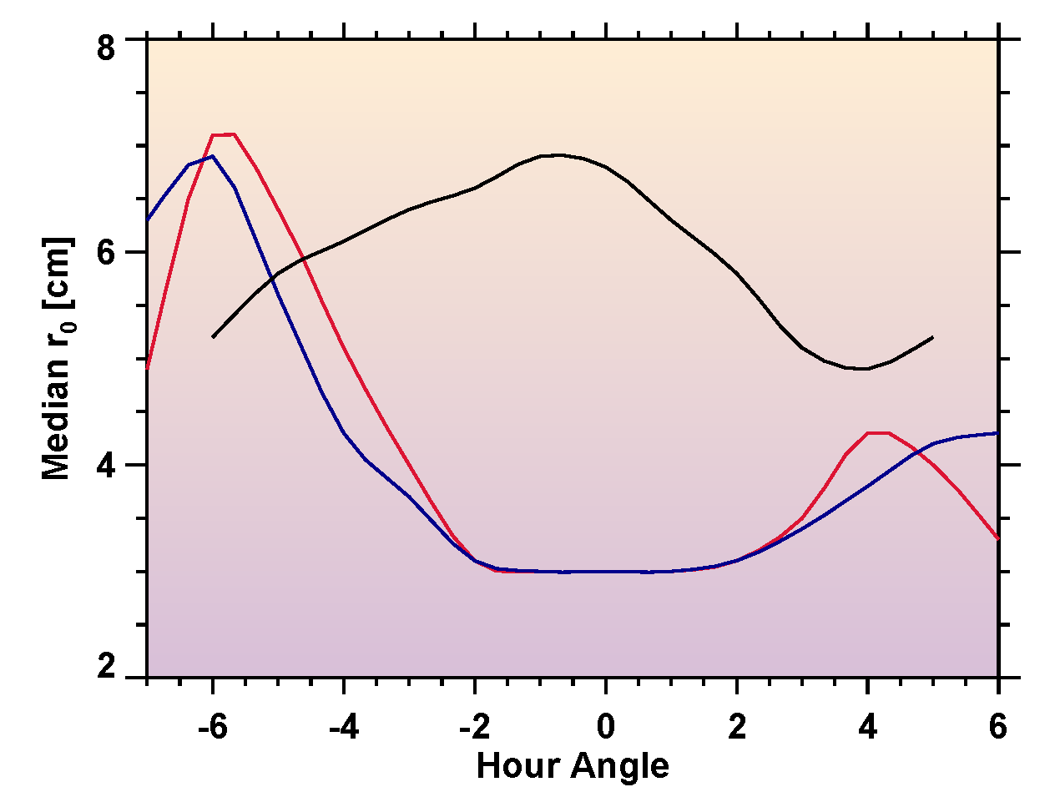
NST and its Science Instruments:
Commissioning, Upgrades and Future
Wenda Cao & NST Team
BBSO was built by Caltech in 1969.
Observatory was transferred from Caltech to NJIT in July 1997.
The dome sits at the end of a 1000 ft. causeway on Big Bear Lake’s north shore at 6,750 foot elevation.
The surrounding waters of Big Bear Lake reduce ground level convection, and predominate winds bring smooth air flows across the flat surface of the lake providing superb conditions for solar observing.
BBSO is the home of New Solar Telescope - the largest solar telescope.
Notes:
1

Slide 2
The Capability of the NST Instrumentation
Wenda Cao
Big Bear Solar Observatory
New Jersey Institute of Technology
Notes:
2

Slide 3
Notes:
3

Slide 4
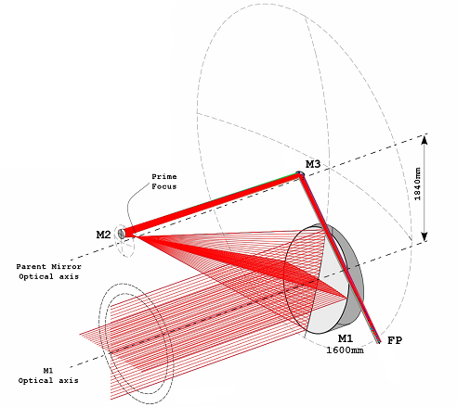
1.6 m Off-axis NST
The NST is an off-axis section of a 5.3 meter, f/0.73 Gregorian telescope. The result is an f/2.4, 1.6 meter system.
The design offers an unobstructed pupil allowing superior adaptive optics performance and low scattered light.
The prime focus, where most of the solar radiation must be absorbed, is accessible without obstructing the light path.
A small (3.5 mm) field stop at prime focus limits the radiation loads transmitted to the downstream optics.
Then NST primary mirror is also a test article for the off-axis mirrors of the GMT, the Giant Magellan Telescope.
Notes:
4

Slide 5
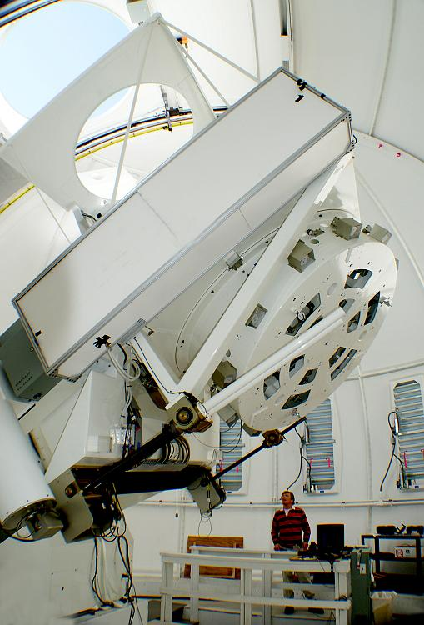
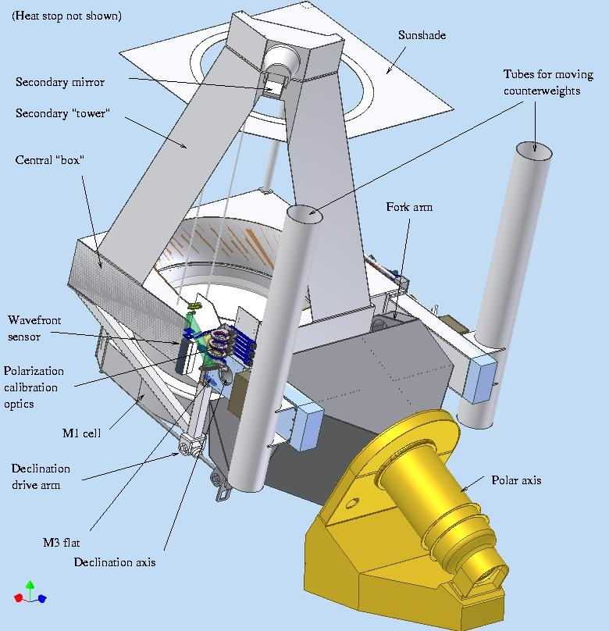
NST Features
All reflecting, off-axis Gregory optical configuration
PM: off-axis 1.6 m clear aperture (1.7 m blank) with f/2.4
Figuring PM to 16 nm rms
Effective focal length: 83.2 m (F/52 at Gregorian focus and F/20 at Coudé focus)
FOV: 3' in prime focus
Wavelength range from 400 nm to NIR in Coudé lab with AO
Integrated active optics (ao) and adaptive optics (AO)
Quasi-static telescope alignment
Diffraction limited: 0.06″@ 500 nm and 0.2″@ 1.56 μm with AO
Polarization calibration optics immediately before M3
Facility-class instruments

Slide 6
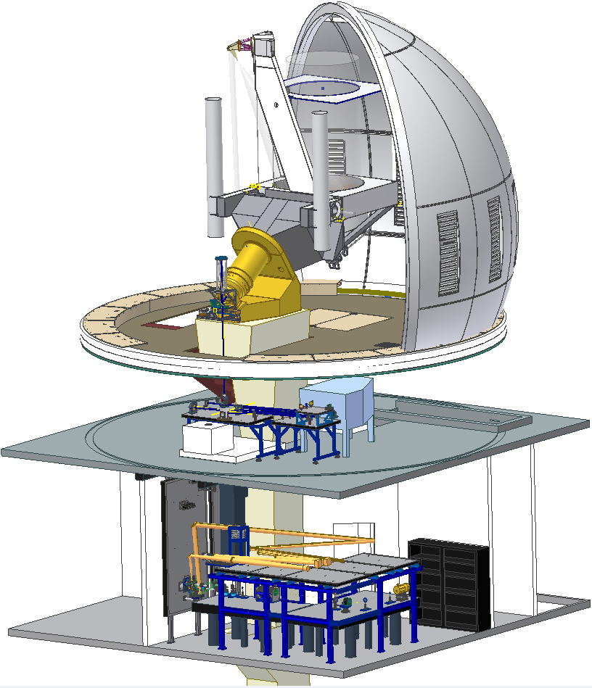
NST Scientific Instruments
Adaptive Optics System (AO: AO-76, AO-308, MCAO) – SPIE.9148.100, SPIE.9148.193
Visible Imaging Spectrometer (VIS, VISP) – SPIE.9147.15
Near InfraRed Imaging Spectro-polarimeters (IRIM, NIRIS) – SPIE.9147.127
Cryogenic Infrared Spectrograph (CYRA) – SPIE.9147.129
Broad-band Filter Imager (BFI)
Fast Imaging Solar Spectrograph (FISS)
CYRA
AO
FISS
BFI
MCAO
VIS
NIRIS
Notes:
6

Slide 7
NST Scientific Instruments
Instrument | Dispersing System | Fore-Optics | Wavelength Coverage | Detector System
Broadband Filter Imager (BFI) | Interference Filters | Beam Splitter or Phase Diversity | 380 – 900 nm | Visible CCD/CMOS
Visible Imaging Spectro-polarimeter (VIS, VISP) | Visible Tunable Filter | Dual Visible FPIs and Polarization Analyzer | 550 – 860 nm | Visible CCD/CMOS
Near-IR Imaging Spectro-polarimeter (IRIM, NIRIS) | Near-IR Tunable Filter | Dual Near-IR FPIs and Polarization Analyzer | 1000 – 1700 nm He I 1083 nm, Fe I 1565 nm | Near-IR FPA
Fast Imaging Solar Spectrograph (FISS) | Medium Dispersion Spectrograph | Warm Optics and Grating | Visible light Ha 656 nm, Ca II 854 nm | Visible CCD
Cryogenic Infrared Spectrograph (CYRA) | Medium Dispersion Spectrograph | Cryogenic Optics, Cold Grating | 1000 – 5000 nm | Mid-IR FPA
Notes:
7

Slide 8
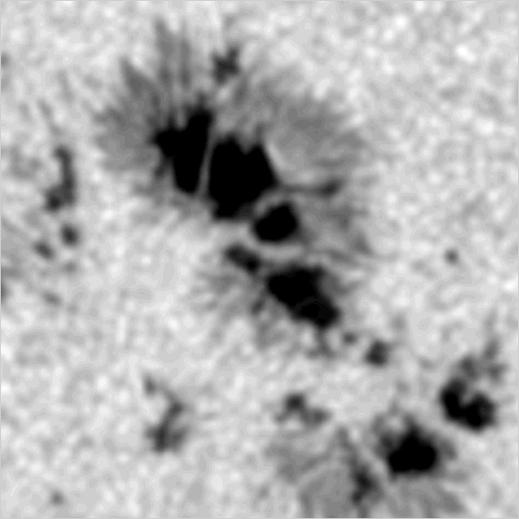
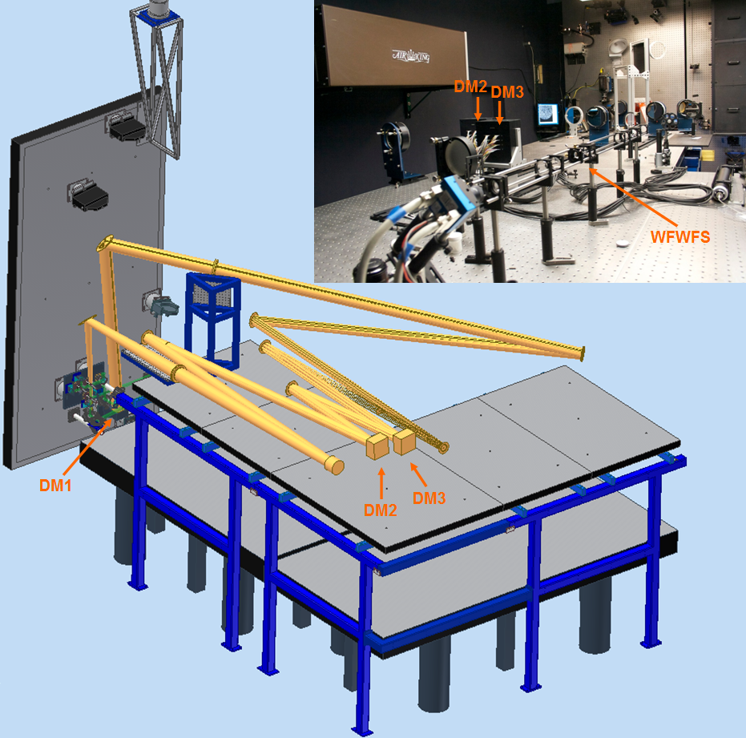
NST AO and MCAO
1st Generation AO-76
Strehl ratio: 0.7 in the NIR under median BBSO seeing
2nd Generation AO-308
Acquire diffraction limited imaging over the telescope’s full range of operation
3rd Generation MCAO
Expand field of view of diffraction limited observations to ~ 1’ in the visible
AO-76, AO-308 and MCAO represent a successful collaboration between BBSO/NJIT, KIS and NSO
Notes:
8

Slide 9
Broad-band Filter Imager
Highest possible spatial and temporal resolution photometric observation
Serves as scientific analysis and engineering feedback
Reference images for alignment with space instruments
Typical exposure: 0.8 – 1.5 ms
Typical burst cadence: 10 – 15 s
Available channels:
Speckle reconstruction post-processing with parallel computers
BFI
Notes:
9

Slide 10
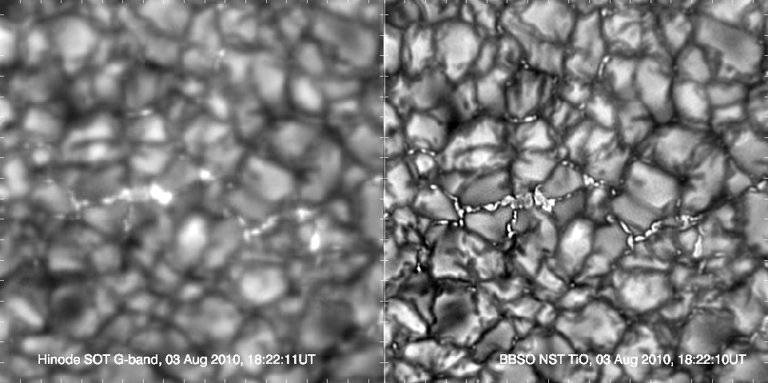
Hinode SOT vs NST BFI
Courtesy : F. Wőger & O. von der Lühe and KISIP v.6
BBSO: V. Yurchyshyn
Notes:
10

Slide 11
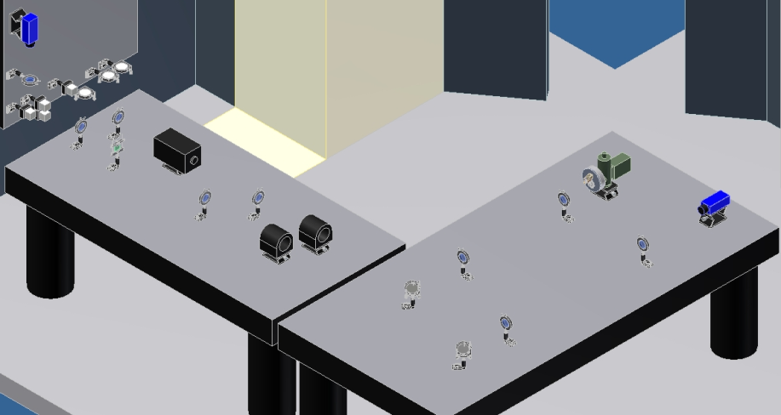
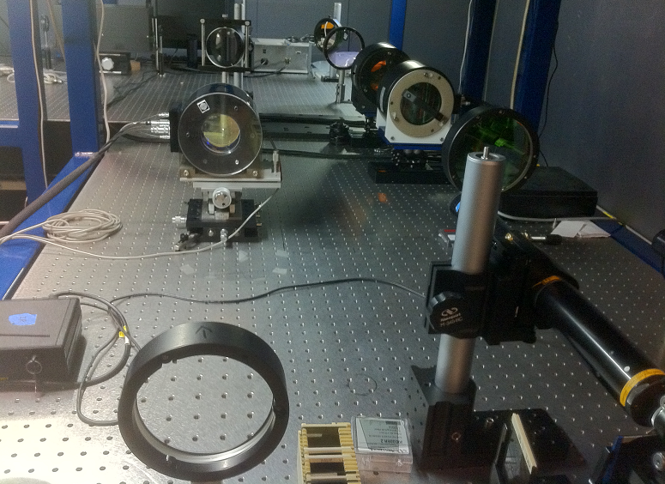
Visible Imaging Spectrometer
Single Fabry-Pérot etalon (D = 70 mm) plus narrow band interference filter
Wavelength coverage: 550 – 700 nm
Band pass: 5.8 – 8.2 pm
Telecentric configuration with F/120
Available spectral lines:
Hα (656.3 ± 0.15 nm)
Fe I (630.2 ± 0.15 nm)
NaD₂ (588.9 ± 0.15 nm)
more lines are coming as needed …
Field of view: 75”(H) by 64”(V)
High speed computer with SSD HDs
Spectroscopy cadence: a 11 points scan with multi-frames selection: < 15 secs
Notes:
11

Slide 12
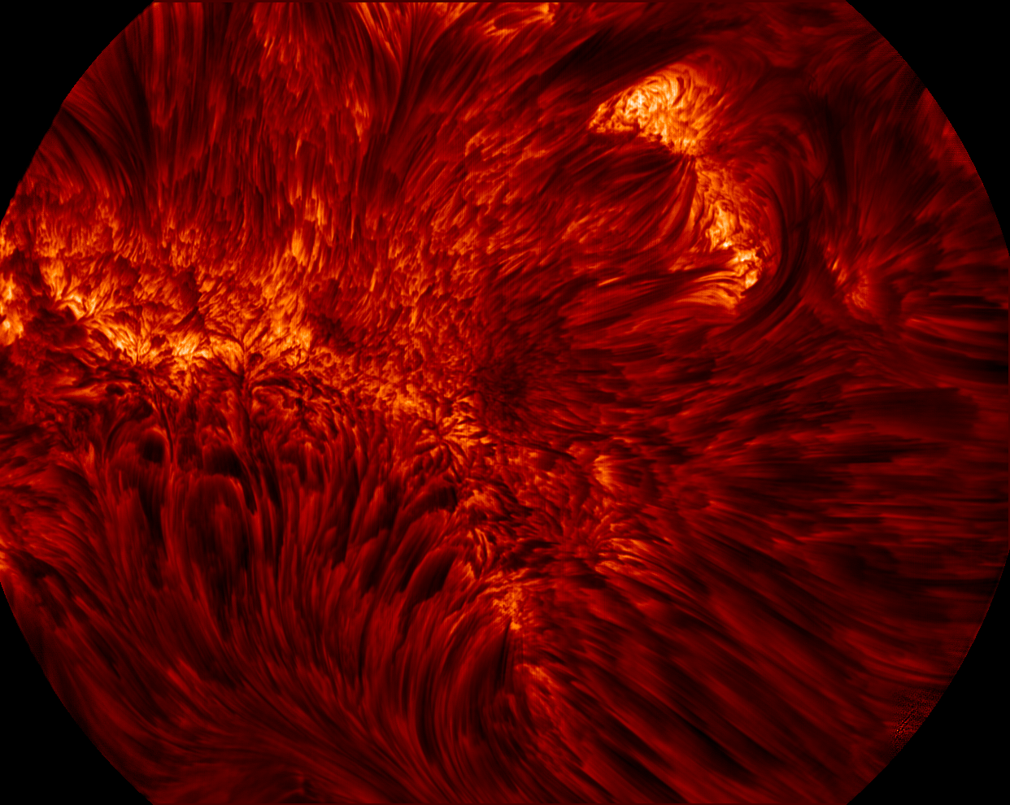
VIS Spectroscopy Observation
Notes:
12

Slide 13
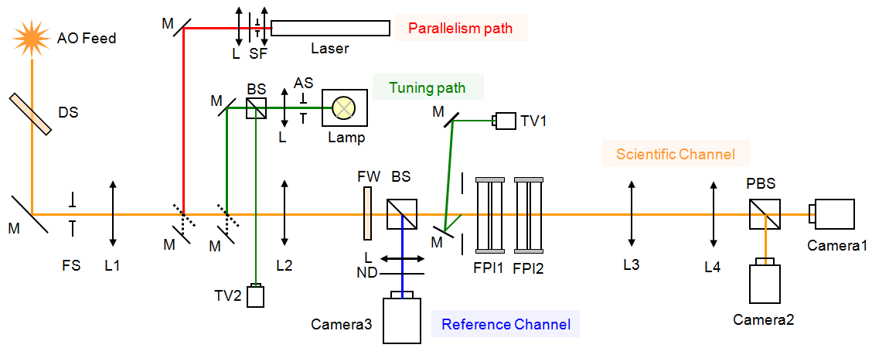
2nd Generation VISP
Dual Fabry-Pérot etalons with apertures of 100 mm
Wavelength coverage: 550 – 860 nm
Spectral lines candidate
Hα 656.3 nm
He I D3 587.6 nm
Na I D2 588.9 nm
Fe I 630.2 nm
Ca II 854.2 nm
More lines as needed …
Field of view: 85” round
Telecentric configuration (> F/150)
Scientific channel and reference channel
Parallelism path and tuning paths
Etalon coating and cavity spacing design
Dual beam polarimetry
Achromatic rotating waveplate
Polarization calibration package
Polarimetry sensitivity: 10⁻⁴ I_{c}
Notes:
13

Slide 14
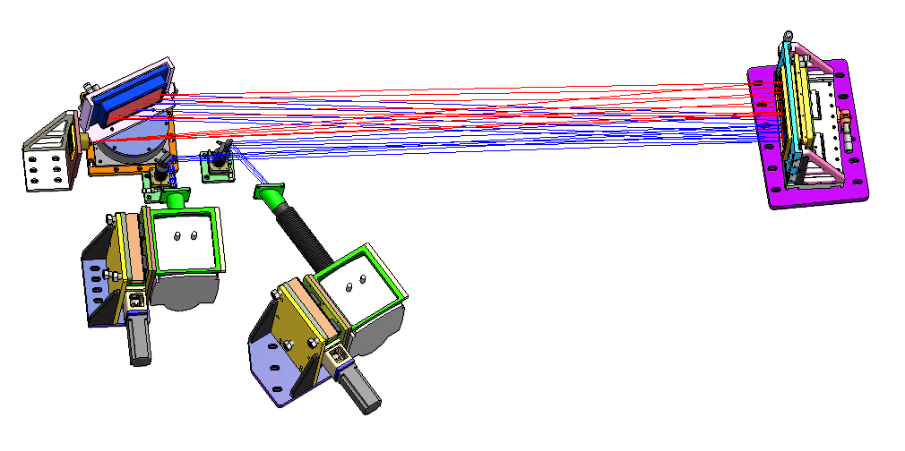
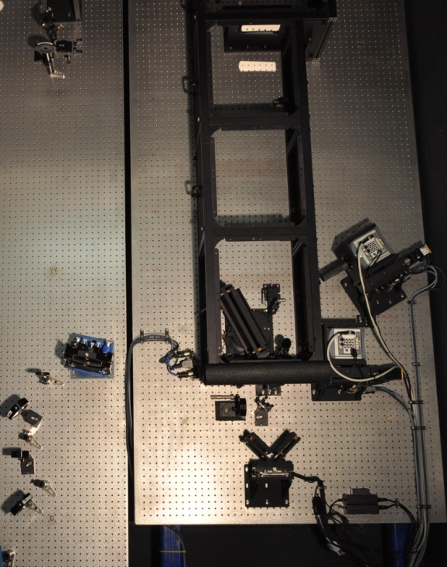
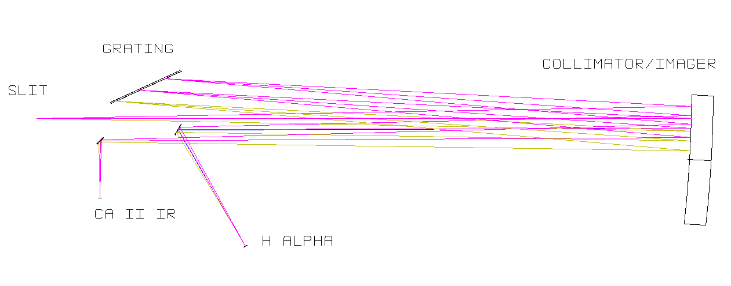
FISS
FISS – Fast Imaging Solar Spectrograph
A collaboration between BBSO and Korean Solar Community
Focus on fine structures of chromosphere: filaments, spicules, mottles, jets microflares …
Slit-scan imaging spectrograph
Quasi-Littrow configuration
Spectral resolution : 1.4×10⁵
60” scanning cadence : 60 sec.
Dual-band spectra at H_{α} and Ca II 854 nm using dual CCD cameras
Echelle grating with order-selecting filters
Notes:
14

Slide 15
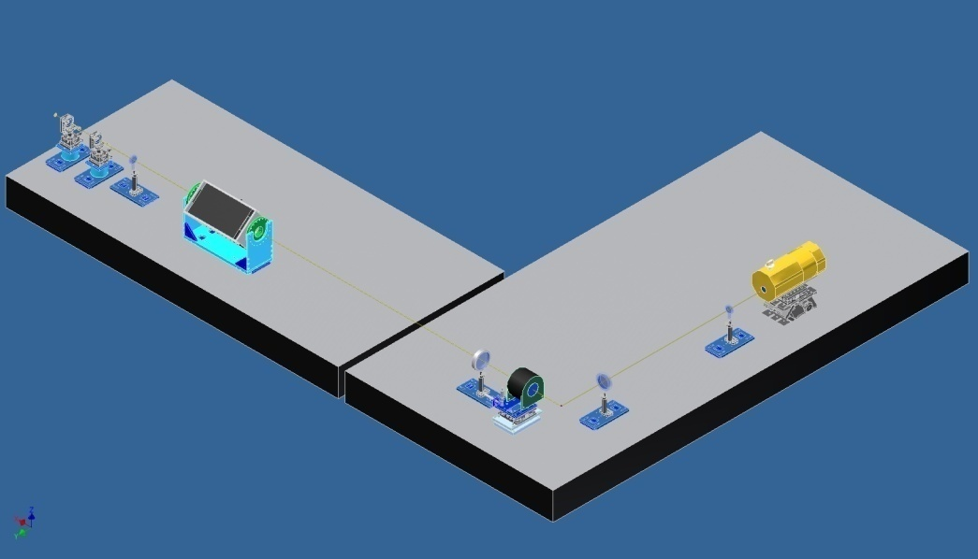
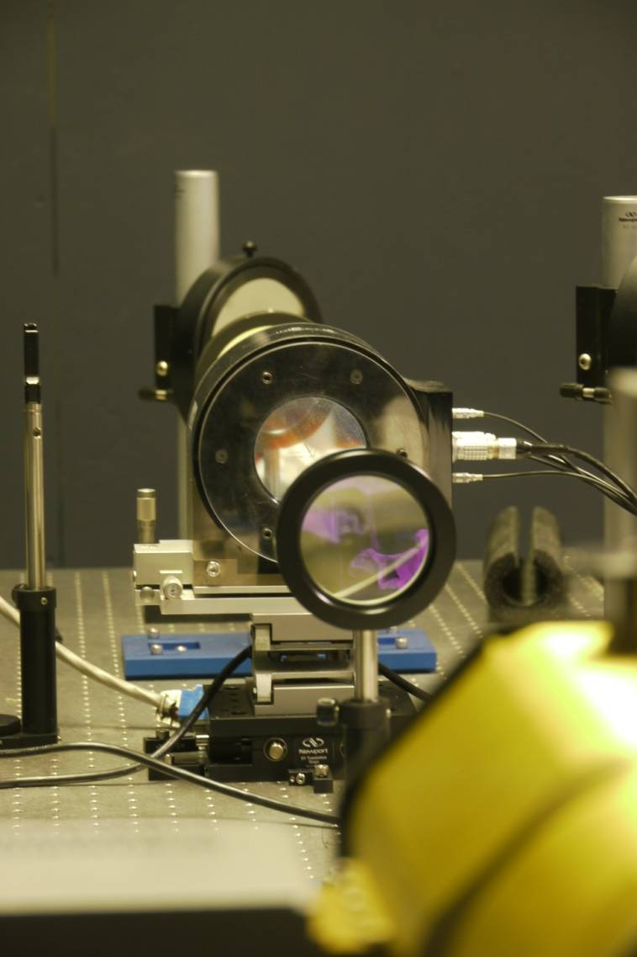
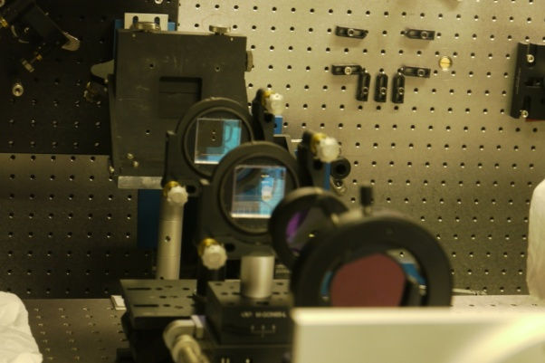
1st Generation IR Magnetograph: IRIM
NIR Fabry-Pérot etalon plus Lyot filter and interference filter
Wavelength coverage: 1 – 1.7 μm
Fe I 15648.5 Å & Fe I 15652.9 Å
Band pass: 10 pm
Telecentric configuration with F/120
Field of view: 50” by 25”
Dual beam polarimetry
Rotating waveplate modulator
Spectral resolving power: > 10⁵
Zeeman sensitivity: ~ 10⁻³ I_{c}
Spectrometric cadence: < 15 s
Spectro-polarimetry cadence: < 45 s
Notes:
15

Slide 16
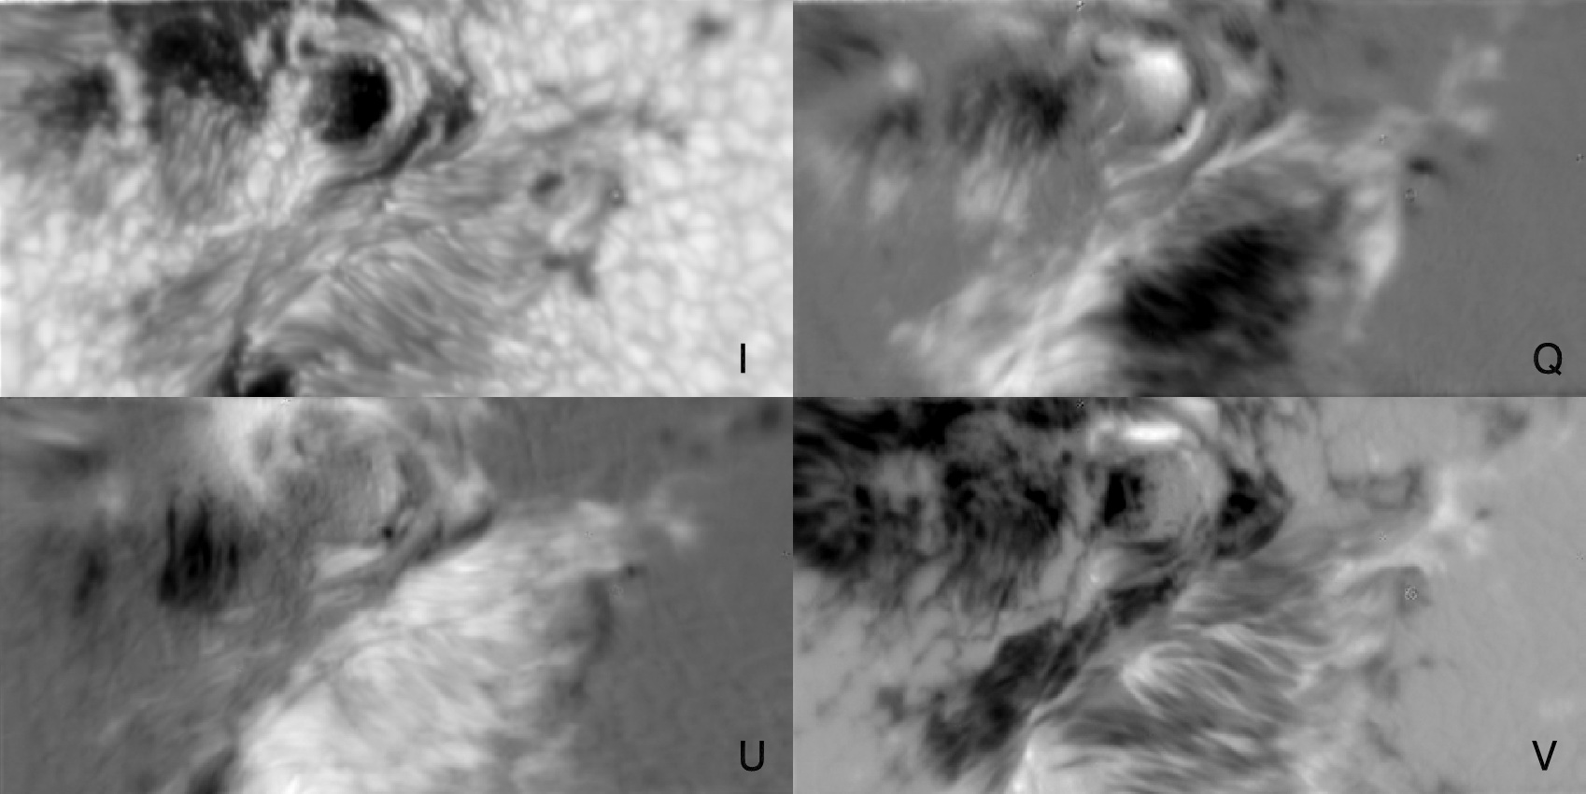
IRIM Observations
Implement telescope polarization calibration in collaboration with NSO
Develop priority scientific program and define observing sequences …
Integration of Stokes inversion code in collaboration with Stanford
Upgrade IRIM into dual Fabry-Pérot etalon system (NIRIS)

Slide 17
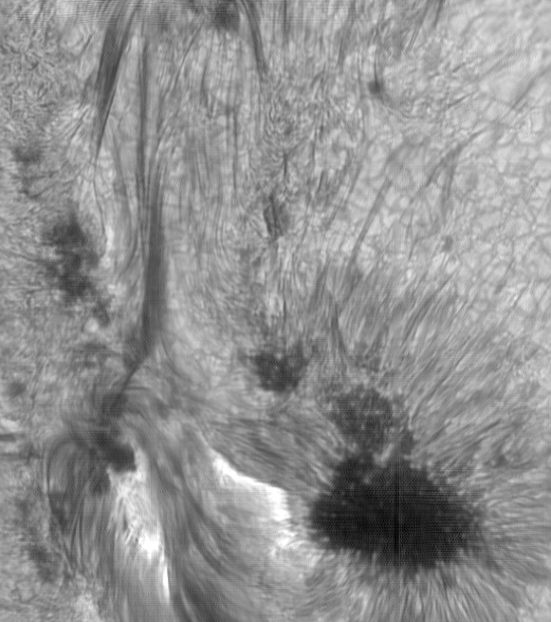
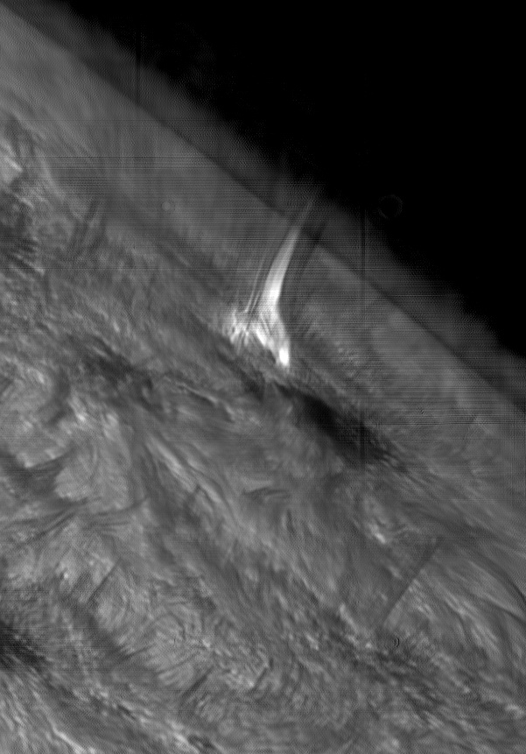
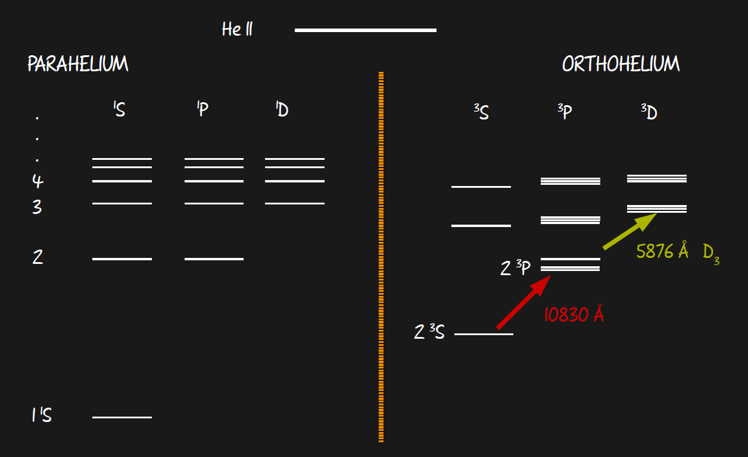
He I 1083 nm Observations
He I triplet: 10829.091, 10830.250, 10830.340 Å ( g_{eff} = 2.0, 1.75 and 1.25, respectively), arising as a transition between the 2³P_{0,1,2} and the 2³S₁
Excitation mechanism:
Collisional excitation (>20000 K) from the ground level 1¹S₀ parahelium state
Photoionization (coronal UV and X-ray) followed by a cascade to 2³S₁
Sensitive to dynamic phenomena, optically thin

Slide 18
He I 1083 nm Observations
A microflare on May 24, 2012
A C9.5 flare on July 5, 2012

Slide 19
A M1.2 flare on August 17, 2013

Slide 20
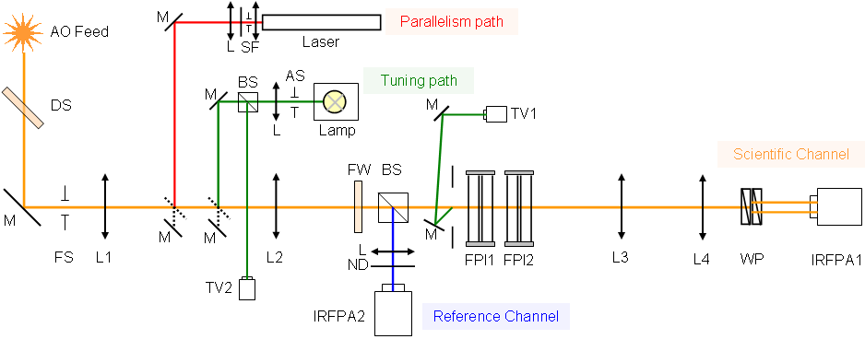
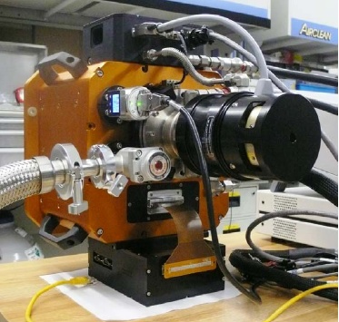
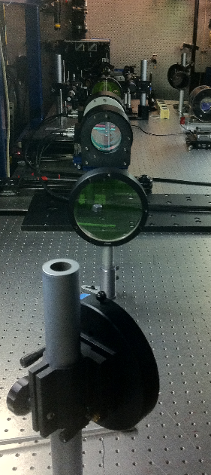
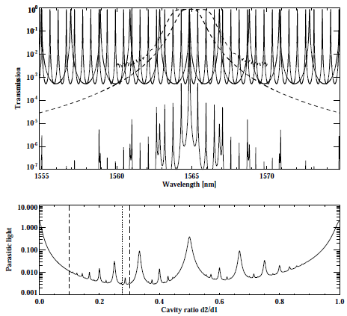
2nd Generation -- NIRIS
Dual Fabry-Pérot etalons with apertures of 100 mm
Wavelength coverage: 1000–1750 nm (He I 1083 and Fe I 1565 nm)
New HgCdTe 2K by 2K camera with a frame rate up to 65 Hz
Field of view: 85” round
Dual beam polarimetry
Achromatic rotating waveplate
Spectral resolving power: > 10⁵
Telecentric optical configuration
Polarimetry sensitivity: 10⁻⁴ I_{c}
Vector spectro-polarimetry cadence: < 20 secs
Notes:
20

Slide 21
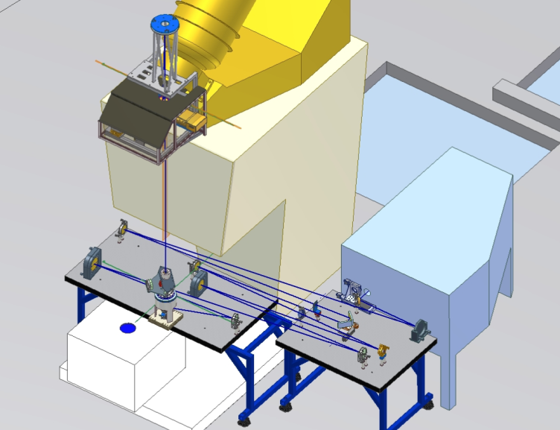
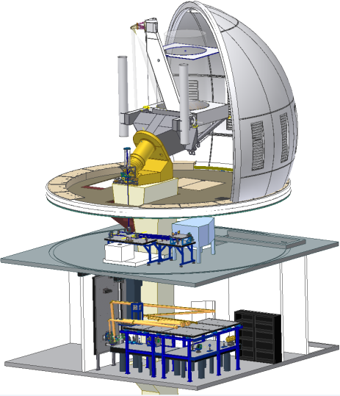
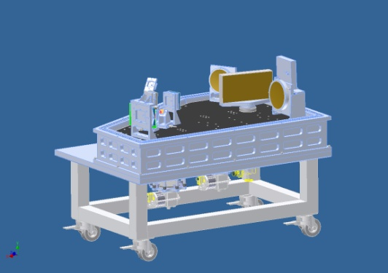
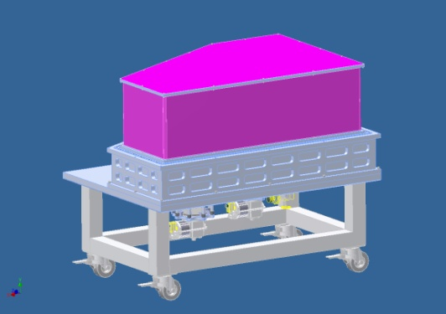
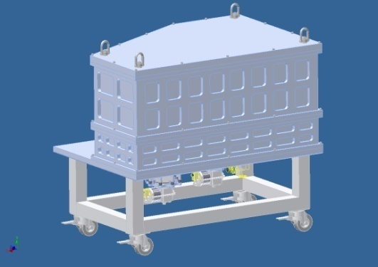
Cryogenic IR Spectrograph
CYRA is in its construction phase, a collaboration with NSO, HAO & UH
Fully cryogenic IR solar spectrograph
Scientific motivation
Dynamics of weak photospheric field
Chromospheric field variation with altitude
Characterize cool regions in chromosphere
Dimmer targets: umbra, off-limb …
High Zeeman Sensitivity: δλ ~ λ²g_{eff} B
NIR Bands of Interest for CYRA
TiI 2.231 μm, λgeff = 5578, photosphere
FeI 4.064μm, λgeff = 5080, photosphere
SiI 4.143 μm, λgeff = 9321, photosphere
CaI 3.697 μm, λgeff = 4067, chromosphere
MgI 3.682 μm, λgeff = 4307, chromosphere
CO 4.6 molecular band, chromosphere
High spatial resolution, high cadence spectrometry and polarimetry
CYRA
Notes:
21

Slide 22
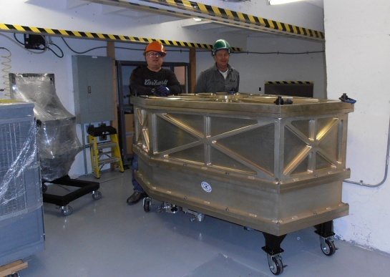
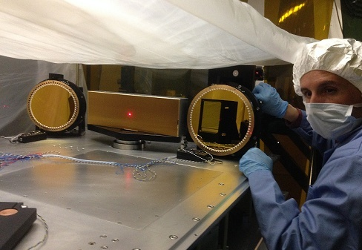
Cryogenic IR Spectrograph
Operating Temperature of 77 K to minimize background thermal emission
Spectral range 1.0 to 5.0 μm
Spectral resolving power > 10⁵
Spatial resolution: diffraction-limited for wavelengths > 2 μm
Temporal modulation 10 Hz with dual beam differential polarimetry
Field of view: 75"
Image stabilization: Tip/tilt
Image rotation compensator
image scanner, context imaging and guiding
HAWAII 2RG 2K×2K HgCdTe camera with a frame rate up to 65 Hz
Notes:
22

Slide 23
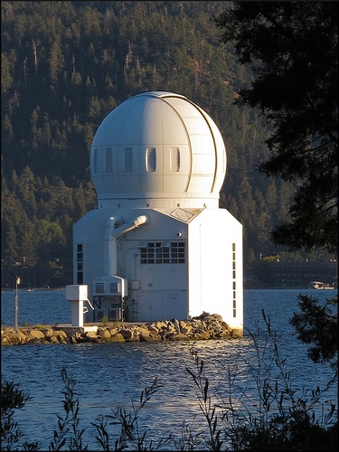
1.6 m NST, 2009
Summary
The 1.6 m NST is the largest aperture, highest resolution solar telescope before our flagship - 4 m DKIST is online in 2019.
The 1.6 m NST is the largest aperture off-axis telescope before ATST/GMT comes online.
NST facility-class instruments from AO, CYRA to spectro-polarimeters are ideal testbeds/pathfinders for many instruments of next generation ground-based or space solar telescopes, like DKIST, CGST, Solar-C ….
NST and its instruments will provide the solar community with unprecedented high resolution photometric, spectroscopic and polarimetric data covering from the spectral range from 400 nm to 5 μm, to probe the solar atmosphere from the deepest photosphere to the base of the corona, and from the quietest to the most active Sun.
Notes:
23

Slide 24
Acknowlegement
NST Project is supported by NJIT, US NSF, NASA, AirForce, NOAC, KASI
NST Team: Philip R Goode, Roy Coulter, Wenda Cao, Nicolas Gorceix, John Vasik, Sergiy Shumko, Jeff Nenow, Kwangsu Ahn, Vasyl Yurchyshyn, Volodymry Abramenko, Algae Kellerer, Dirk Schmidt, Claude Playmate, Seonghwan Choi, Randy Fear, Xianyu Zhang
NST Collaborators: Thomas Rimmele, Jeff Kuhn, Gil Moretto, Fredrich Woger, Haisheng Ji, Jongchul Chae, Matt Penn, David Elmore, Young-Deuk Park, Wolfgang Schmidt, Oscar van de Luhe, Jose Marino
Notes:
24

