Slide 1
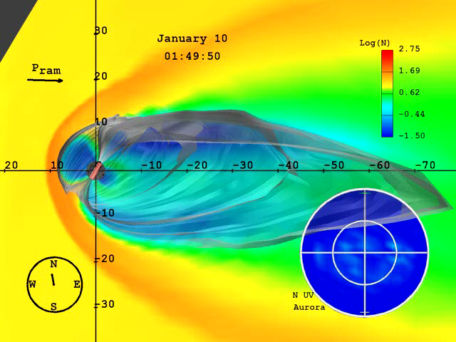
Relationship Between Earth Directed Solar Eruptions and Magnetic Clouds at 1AU
Vasyl Yurchyshyn, Big Bear Solar Observatory, www.bbso.njit.edu/~vayur
in collaboration with V. Abramenko, D. Tripathi, Q. Hu, R.P. Lepping, B. Lynch, J. Krall, J. Qiu, H. Wang

Slide 2
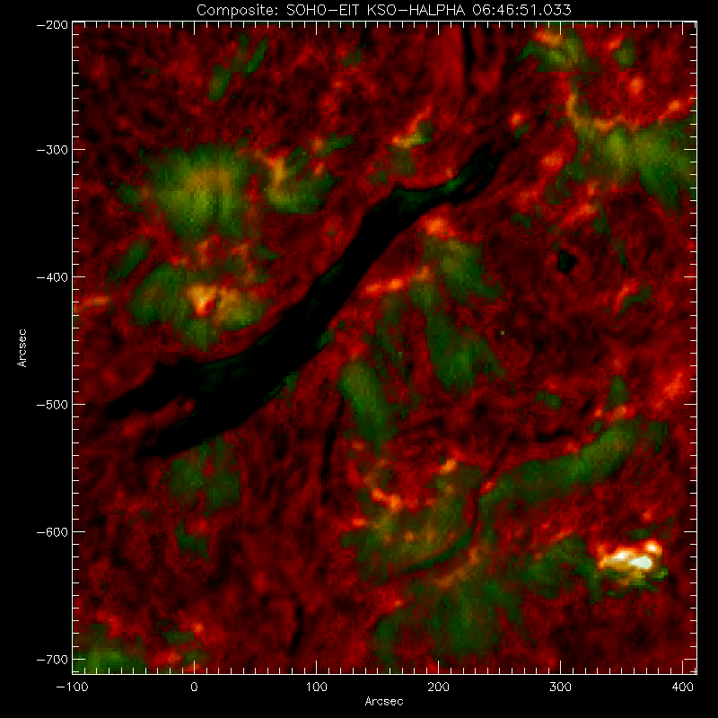
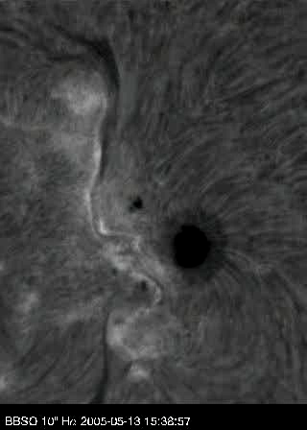
Kinked Eruption
Sept 12, 2000
May 13 2005
Courtesy of Global Halpha Network

Slide 3
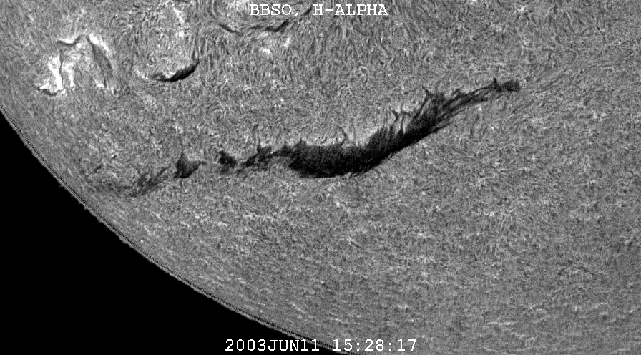
Eruption Dynamics – Flux Rope Rotation

Slide 4
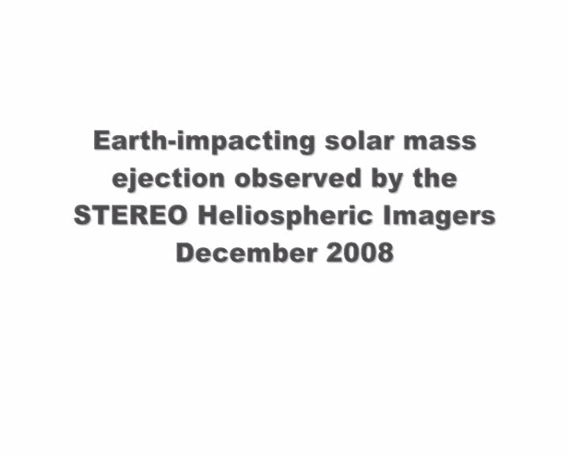

Slide 5
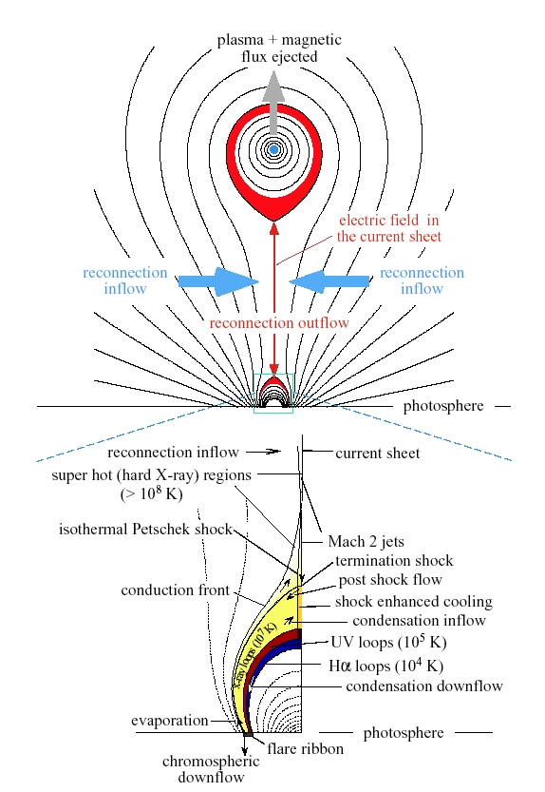
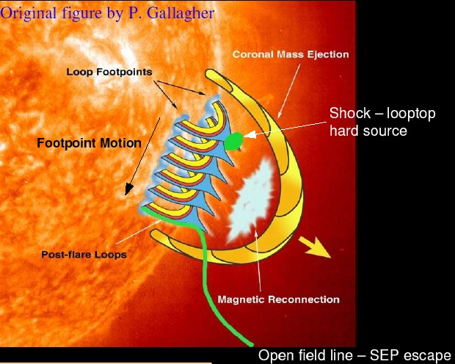
Lin & Forbes, 2002, JGR 105, 2375
CME models predict that the structure of erupted fields can be represented by a flux rope.
CMEs often exhibit a 3 part structure which is interpreted as an expanding magnetic flux rope (Chen 1996; Low 2001). Flux rope features are not uncommon in CMEs (Li et al., 2001; Manoharan et al., 2001; Krall 2006).
Flux Rope
Gallagher, Smith: Hudson’s Cartoon Archive

Slide 6
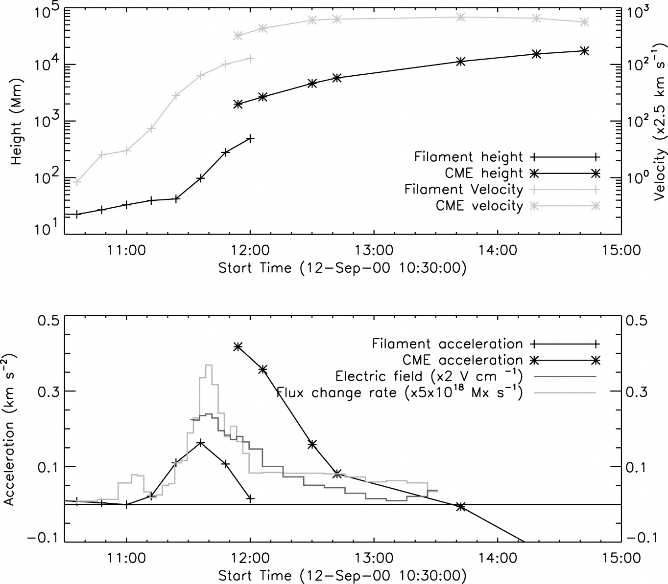
KSO Ha Filament and LASCO CME
LASCO CME Height
Flux Rope D=1700Mm=0.01AU→0.6-0.9^{h}
Halpha Filament Height
Qiu et al. 2004, ApJ, 604, 900
Graph demonstrates the idea that the chromospheric filament is located at the bottom of an erupted flux rope

Slide 7
about 40-50% of CMEs are associated with storms
up to 80% of storms are associated with CMEs
(Yermolaev et al., 2005)
reconnection occurs when
CME’s MF and Earth’s MF
have opposite components
solar eruptions
magnetic cloud,
a flux rope
CME
sun
earth
Geoeffectiveness of a halo CME depends on
the field strength in it and
the orientation of the mag. field
Geo. storm is response
of the magnetosphere on
southwardly directed IMF

Slide 8
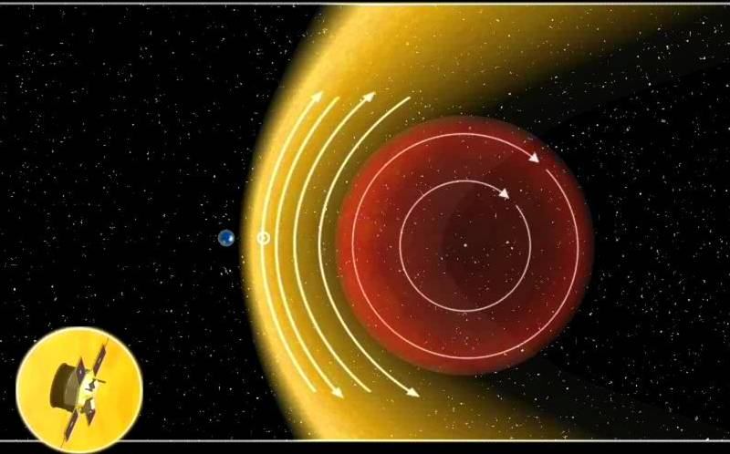
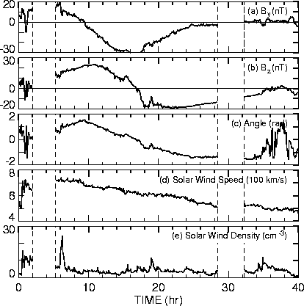
We Can Detect and Measure Ejecta at 1AU
Z
Left handed MC
Y
X
Satellite trajectory
ACE
Y
Z

Slide 9
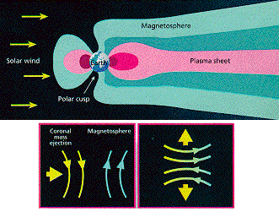
CME geoeffectiveness is determined by
direction of the ejecta
orientation of the ejecta – negative Bz
magnetic field strength;
duration of strong negative fields;
plasma pressure & bulk speed at 1AU;

Slide 10
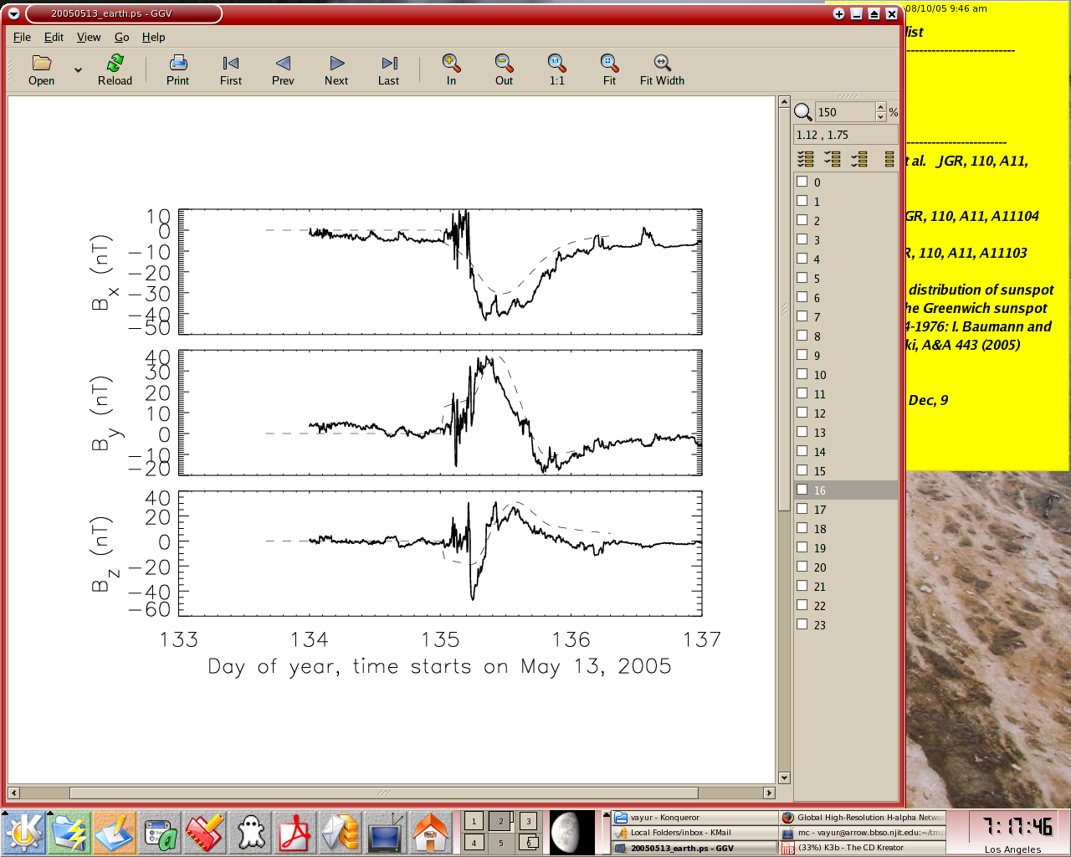
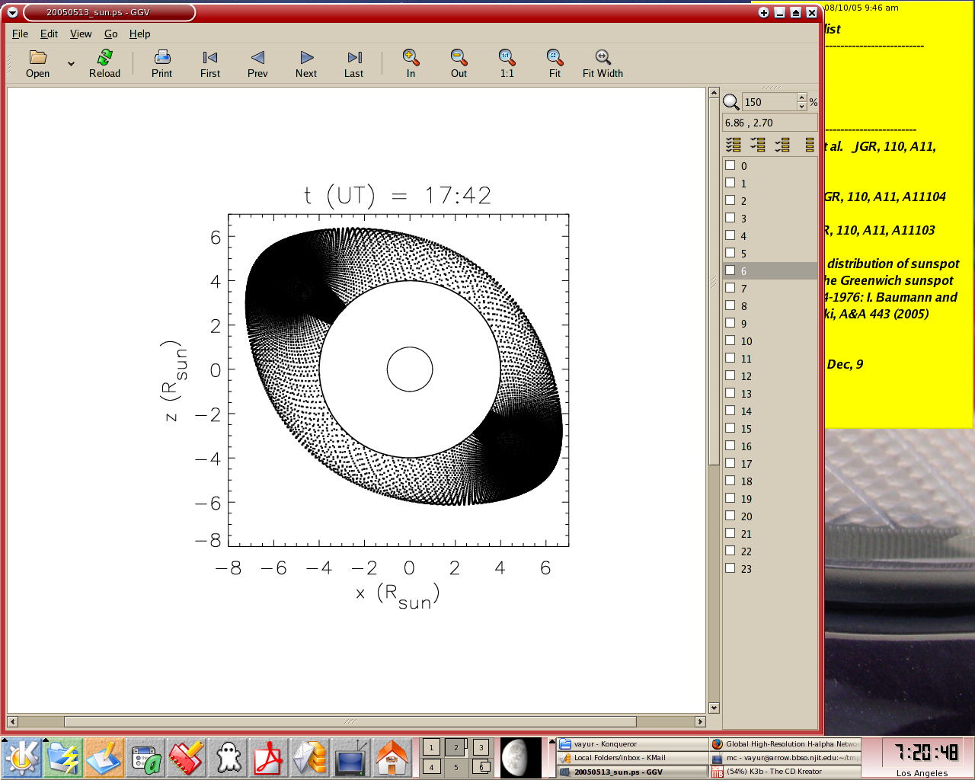
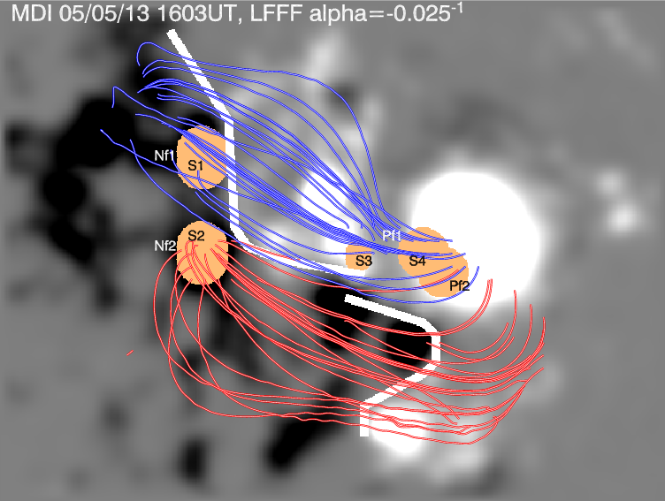
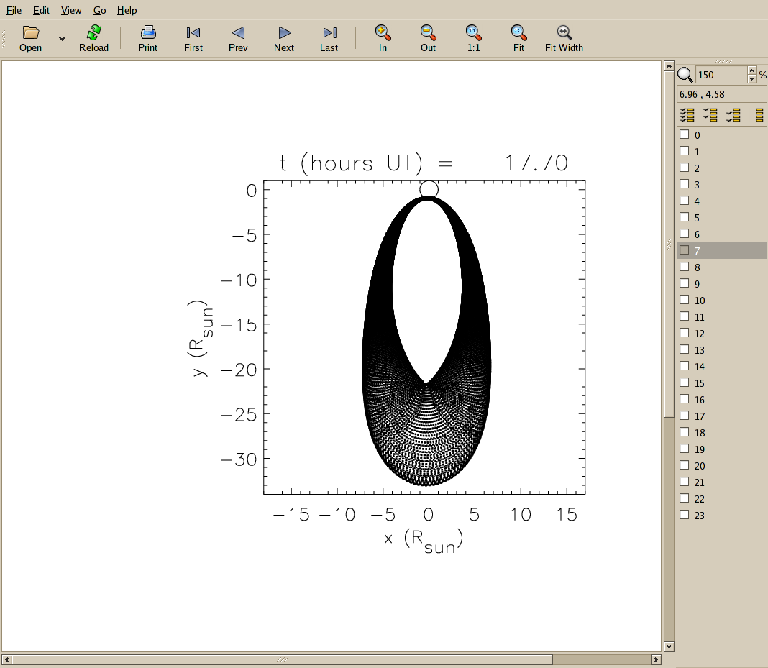
Many ejecta maintain nearly the same orientation and twist as the source regions they are associated with: (Rust & Kumar 1996; Bothmer & Schwenn 1998; Zhao & Hoeksema 1998; McAllister & Martin 2000; Leamon et al. 2002; Ruzmaikin et al. 2003; Rust et al. 2005; Yurchyshyn et al., 2001, 2005, 2006; Qiu et al. 2007).
Solid – ACE
Dashed – Model
sun
sun
earth
Fitting by Jonathan Krall
In this simple case there is an agreement between the orientation and twist of magnetic fields in the active region and in the IFR

Slide 11
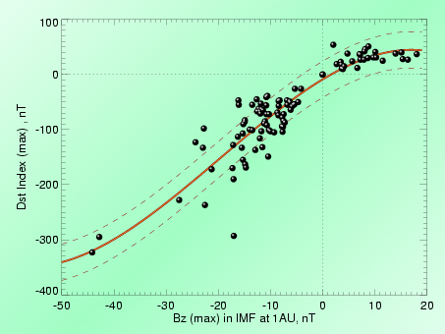
Correlation b/w Bz in MC and the Dst Index
Yurchyshyn, Hu, Abramenko, 2005
Similar conclusions, different data sets:
Gonzalez & Tsurutani, 1987
Cane et al., 2000
Wu & Lepping, 2002
Yurchyshyn et al., 2004
Hourly averaged extremum of the final Dst index vs extremum values of the ACE hourly Bz in the IMF

Slide 12
Field Strength in MCs
MC field intensity is related to the speed of the cloud at 1AU (Gonzalez et al., 2002)
There is a relationship between observed coronagraph CME speeds and MC bulk speed (Lindsay et al. 1999).
This is because
CMEs propagating in interplanetary space asymptotically approach the wind velocity due to the viscous drag high in the corona (Gopalswamy et al. 2001; Wu et al. 2002; Vrsnak & Gopalswamy 2002; B. Vrsnak 2003)
Therefore, the initial CME speed could be related to Bz in a MC and even largely determined by the amount of magnetic flux contained in the flux rope.
Lindsay et al. 1999 noted that faster CMEs tend be associated with larger storms

Slide 13
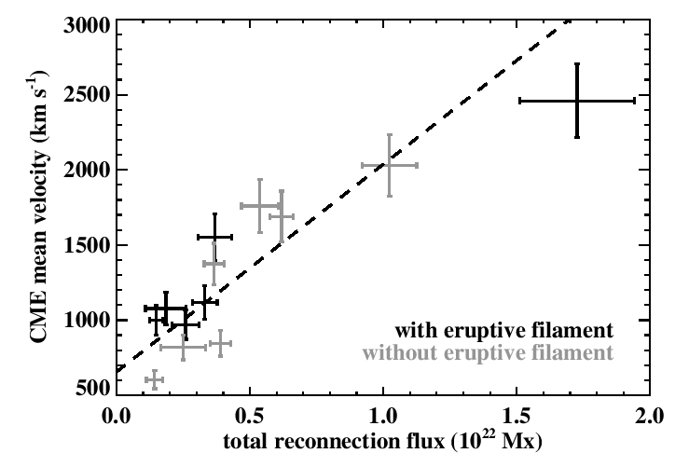
Speed of CMEs vs Magnetic Flux
Qiu & Yurchyshyn, 2005, ApJL
Yurchyshyn, Hu, Abramenko, 2005,
Space Weather, 3, #8, S08C02
The higher the total amount of reconnected flux the higher the speed of that eruption.

Slide 14
Orientation of Interplanetary Ejecta
Southward (↓) Bz: no
Southward (↓) Bz: no
Southward (↓) Bz: yes
Southward (↓) Bz: yes

Slide 15
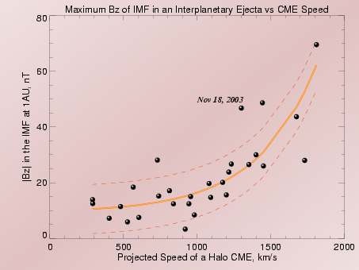
Correlation b/w CME Speed and the Bz
Similar conclusions, different data sets:
Yurchyshyn et al, 2003; 2004
Gonzalez et al. 2004
Srivastava & Venkatakrishnan 2004
This relationship might reflect the fact that an eruption is driven by the Lorentz force, which is directly related to the amount of the magnetic flux
confined in the flux rope.
Other factors can contribute to the scatter
(e.g., Liu & Hayashi 2006)
Yurchyshyn et al. 2003; 2004; 2005
The hourly ACE Bz in the IMF vs
the LASCO projected CME’s speeds

Slide 16
ICME-SW Interaction
Odstrcil & Pizzo (1999a; 1999b)
Heliospheric current sheet interacts with solar ejecta
As the magnetic field is distorted, it drapes around the ejecta and causes its deflection in longitude and/or azimuth
However, details of this ICME-HMF interaction are not yet studied well and the scale of the effect that the heliosphere has on ICMEs, is largely unknown.

Slide 17
Heliospheric Current Sheet
Data & Analysis
HCS interacts with solar ejecta: whenever the ejecta are moving at a faster speed than the upstream plasma there must be an upstream influence
Crooker et al. (1993) suggested that the base of the HCS, which may be observed as a coronal neutral line (CNL)
HCS is considered to be a conduit for CMEs (Crooker et al., 1993) and the angular position (orientation) of the ejecta may, in general, be affected by its large-scale structure
When HCS is not aligned with the ejecta's plane, it is expected that the CME may displace the heliospheric magnetic field as it expands in the heliosphere (Smith 2001)
As the magnetic field is distorted, it drapes around the ejecta and causes its deflection in longitude and/or azimuth
Mulligan et al. (1998) and Zhao & Hoeksema (1996) suggested that, on average, tilt of MC axes may correspond to the global tilt of the HCS
However, details of this CME-HMF interaction are not yet studied well and the scale of the effect that the heliosphere has on CMEs, is largely unknown.

Slide 18
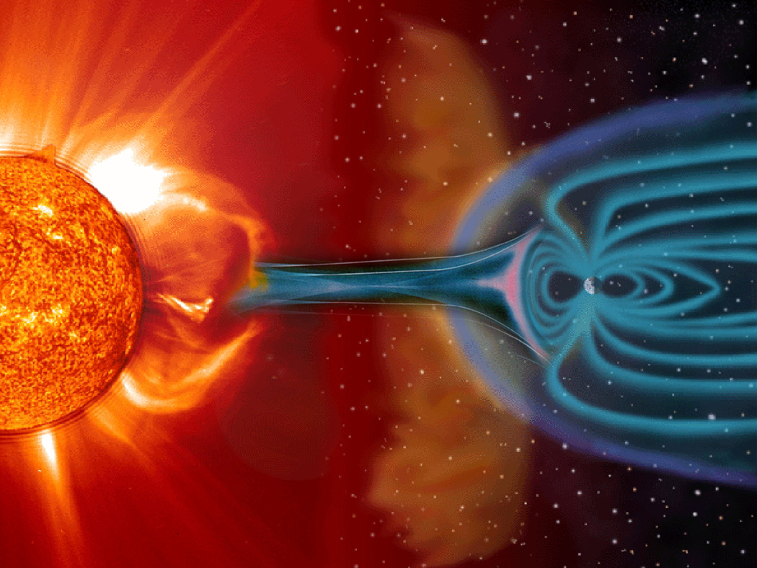
PEA - CME – SW - MC
Relationship: Inferring MC Orientation from Solar Data
PEA
CME
HCS
We will measure orientations of post eruption arcades (EIT 295Å), coronal mass ejecta (LASCO C3), heliospheric current sheet (Stanford synoptic maps) and magnetic clouds (various sources) to
advance our understanding of CME origin and evolution

Slide 19
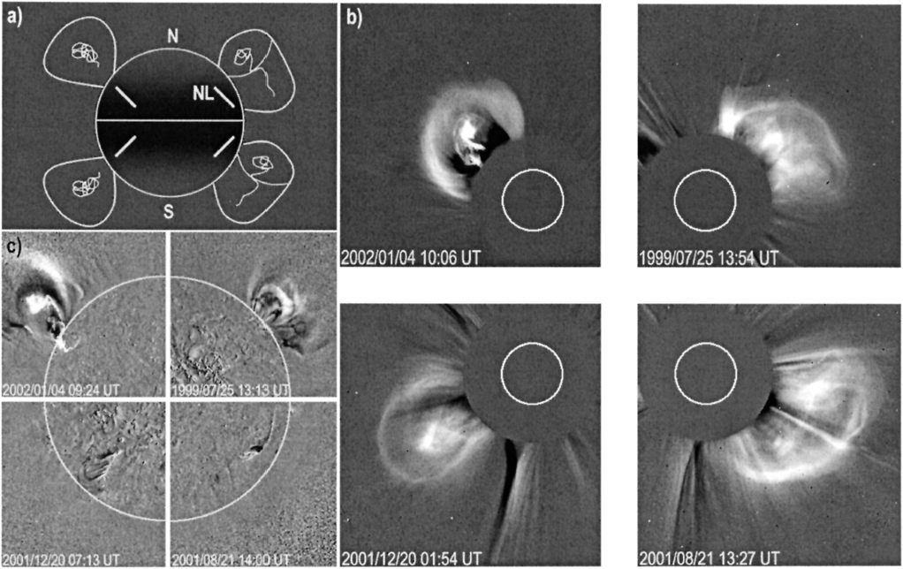
White Light Structure of CMEs
White light morphology of CMEs seems to bear information on their magnetic structure: they are organized in the axial direction, which corresponds to the axis of the underlying erupting flux rope (Cremades & Bothmer, 2004)

Slide 20
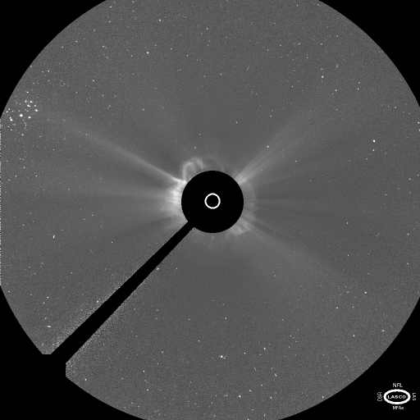
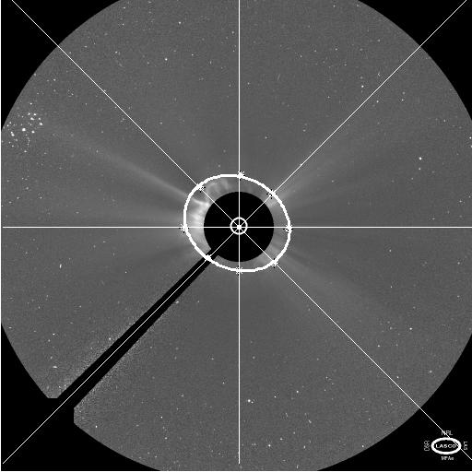
Halo CMEs and Erupting Flux Rope Modeling
In this study we assume that halo elongation indicates the orientation of an erupting flux rope
sun
Model
halo CME
top
view
Solid – ACE
Dashed – Model
earth

Slide 21
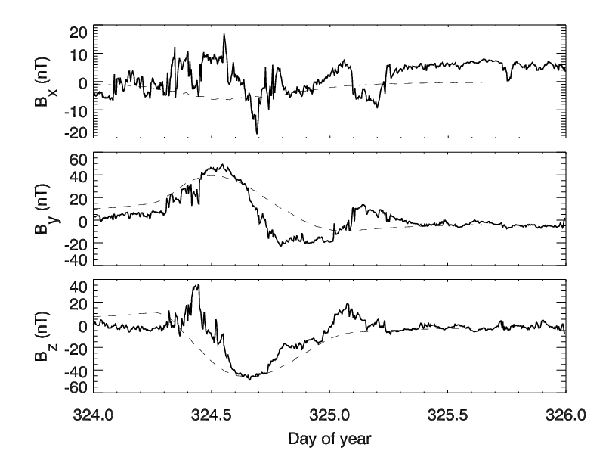
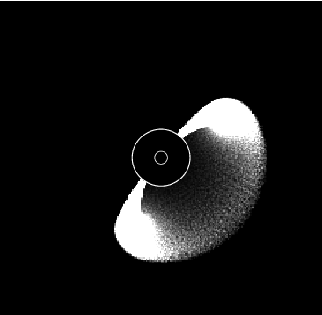
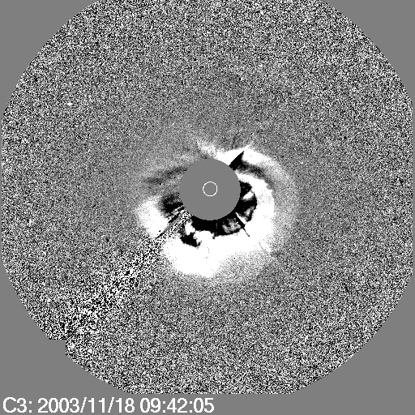
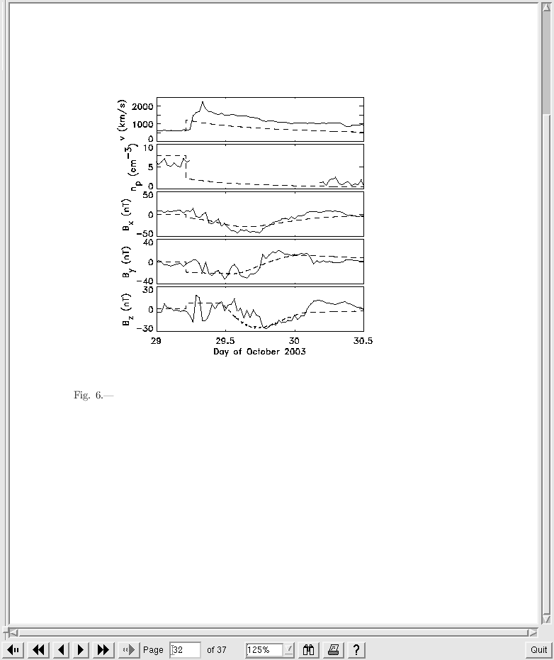
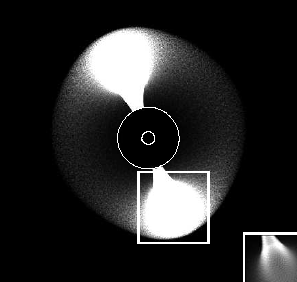
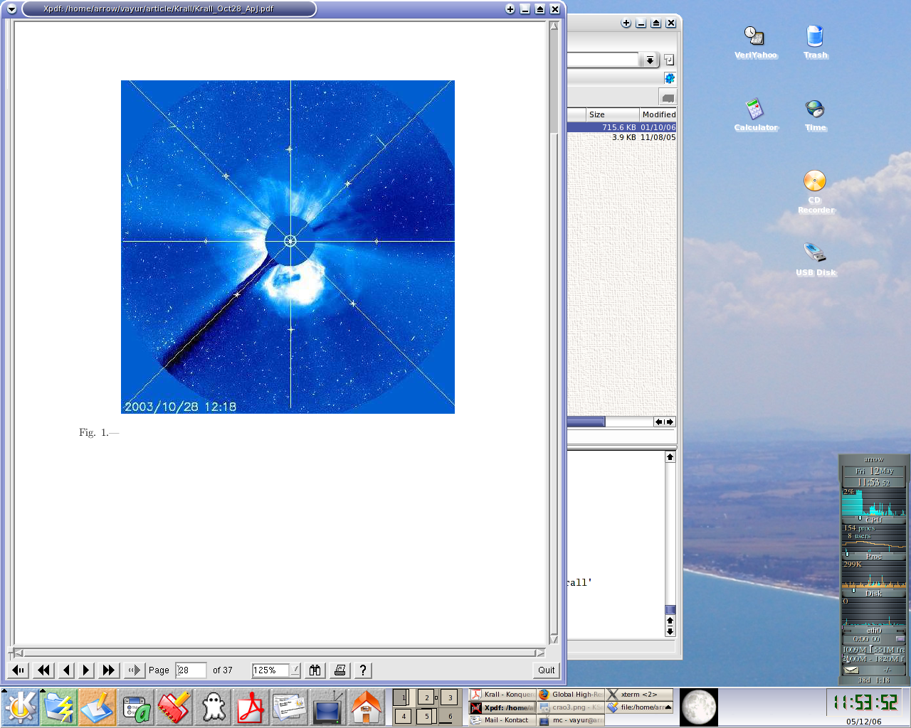
Oct 28 and Nov 18 2003 Events
Nov 18 2003
Elongation of a halo CME closely matches the orientation of the erupting flux rope
Oct 28 2003

Slide 22
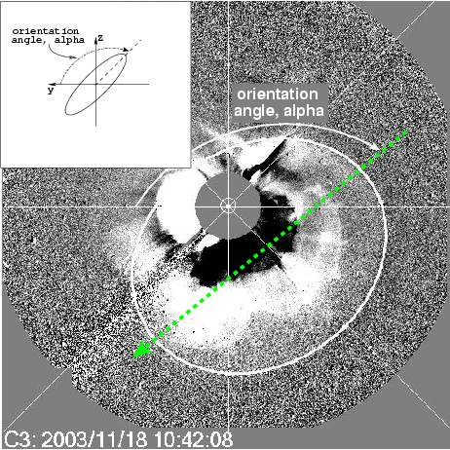
Orientation Halo CMEs
Halo CMEs exhibit various sizes and shapes. Many of them could be enveloped by an ellipse and fitted with a cone model (Zhao, Plunkett & Liu 2002, Xie Ofman & Lawrence 2004; Zhao 2005)
or
measured to determine the direction parameter (Moon et al., 2005; Kim et al. 2008)

Slide 23
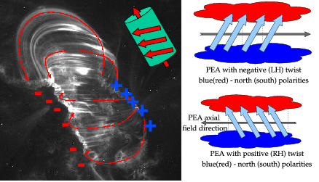
Orientation of Post Eruption Arcades

Slide 24
MC Data & Analysis
MC clock angle was determined using:
  Grad-Shafranov MC reconstruction by Q. Hu
  MC fitting by Lepping et al. (2006)
  MC fitting by Lynch et al. (2005)
  MC fitting with the EFR model
  (J. Krall & V. Yurchyshyn)

Slide 25
PEA - CME – SW - MC
Relationship

Slide 26
PEA - CME – SW - MC
Relationship

Slide 27
PEA - CME – SW - MC
Relationship

Slide 28
PEA - CME – SW - MC
Relationship

Slide 29
PEA - CME – SW - MC
Relationship

Slide 30
PEA - CME – SW - MC
Relationship
PEA
CME
HCS
Yurchyshyn 2008

Slide 31
Green Events: CME – MC are aligned; MC-CNL are aligned too, except 3 events
Red Events: EIT arcade aligned with CME, they both are not aligned with HCS and MC;
CME rotates so that at the end the MC is aligned with the HCS

Slide 32
Typical CME Orientation Profiles

Slide 33
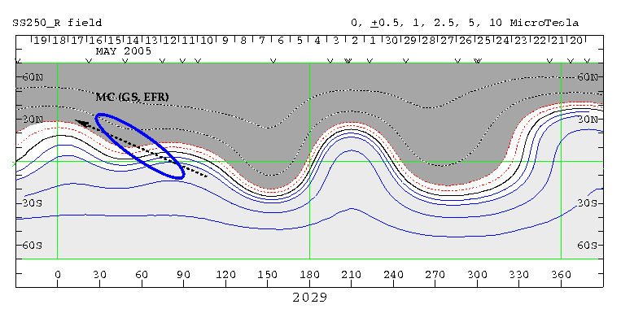
CMEs (and PEA) Orientations versus WSO Neutral Lines

Slide 34
Does HCS affect ICMEs?
Coronal field maps calculated for CR2006 with CCMC/PFSS (top and middle) and MAS models (bottom). Panels a, b and c show maps for source surface radius of 1.6 R, d and e show maps at 2.5 radii, while panel f shows MAS map at 16.5 radii. The thick black contour is the coronal neutral line. The red oval represents the halo CME on Aug 14, 2003, which was aligned with the coronal neutral line at 1.6R􀁿. Magnetic topology has changed further outward from the solar surface so that the neutral line rotated by approx. 50 deg.

Slide 35
CME – MC Relationship
Many ejecta maintain nearly the same orientation and twist as the source regions they are associated with: (Rust & Kumar 1996; Bothmer & Schwenn 1998; Zhao & Hoeksema 1998; McAllister & Martin 2000; Leamon et al. 2002; Ruzmaikin et al. 2003; Rust et al. 2005; Yurchyshyn et al., 2001, 2005, 2006; Qiu et al. 2007).
Some, however, may substantially evolve as they expand out into heliosphere and interact with heliospheric and solar wind magnetic fields:
magnetic field connectivity may change (Gibson & Fan 2006; Lynch et al. 2008);
erupted fields may rotate (Green et al. 2007; Lynch et al. 2008)
interaction with coronal fields and ambient solar wind (Schmidt & Cargill 2003; Liu & Hayashi 2006),
Therefore, the footprint of the associated photospheric fields may weaken and/or disappear altogether.

Slide 36
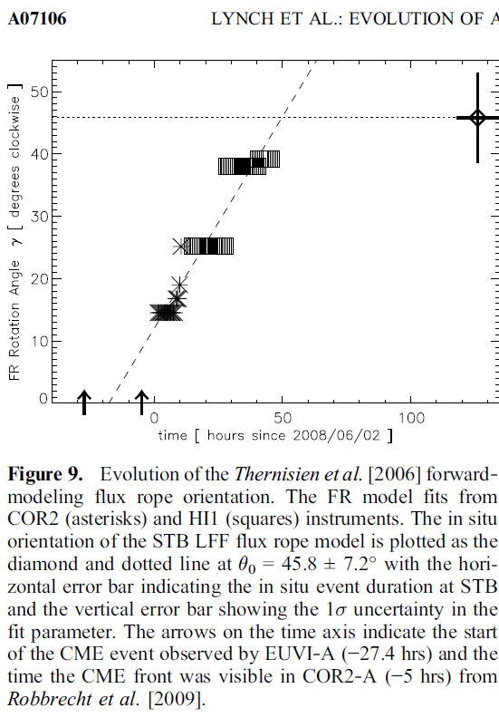
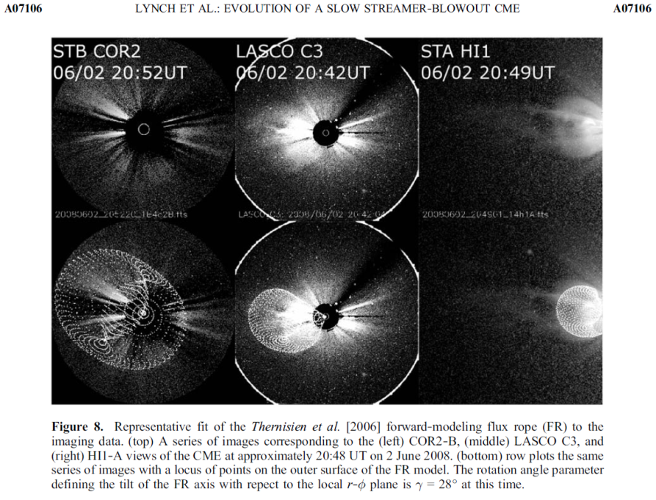
CME Orientation Profile by Lynch et al. 2010, JGR

Slide 37
CME Rotation Rate
Rotation rate, which indicates how fast (deg/h) CME structures rotate
toward to (negative rate) or away from (positive rate) the solar equator.
Average Neg. rate -9 deg/h; Average Pos. rate 4 deg/h
Rotation rate for all events (left) and full halos (right). Distributions are centered near x=-3.0 deg/hour. There are about 60% of events (61 out of 100 for all and 19 out of 32 for full halos) with negative rotation rate, which may indicate that CMEs more often, than not, tend to rotate toward the solar equator.

Slide 38
CME Rotation and Twist of the Source Regions
Analyzed 60 events
About 60% of CMEs have negative rotation rate
Overwhelming majority of the CMEs rotating toward equator were associated with Z shaped (reverse S, negative helicity) structures in North hemisphere
Overwhelming majority of the CMEs rotating toward equator were associated with S shaped structures (positive helicity) in South hemisphere

Slide 39
Conclusions
CMEs seems to rotate as they propagate toward the Earth. They show preference to rotate toward the equator
Rotation occurs between 6-30 Solar Radii, way higher than the helical kink instability predicts
Possible nechanisms: kink instability; JxB force; reconn. w/ ambient field -> footpoint position change; influence of large-scale HMF, which deflects CMEs toward the equator and rotate them at the same time; drag
Need more knowledge, confirmations. Theoretical models of interaction between heliospheric magnetic fields and large-scale magnetic loops tied to the solar surface would be very helpful

