Slide 1
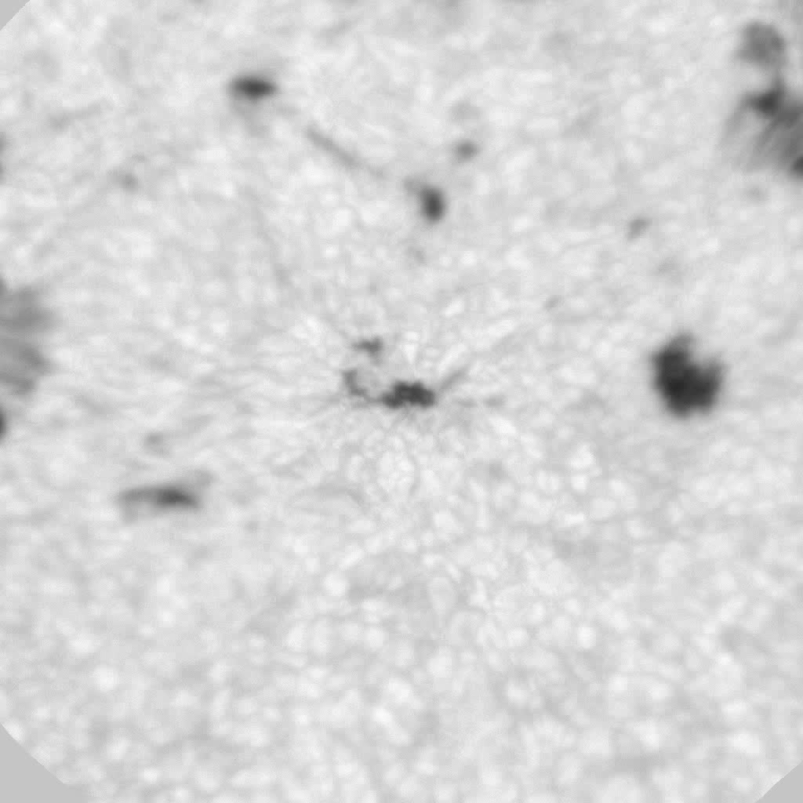
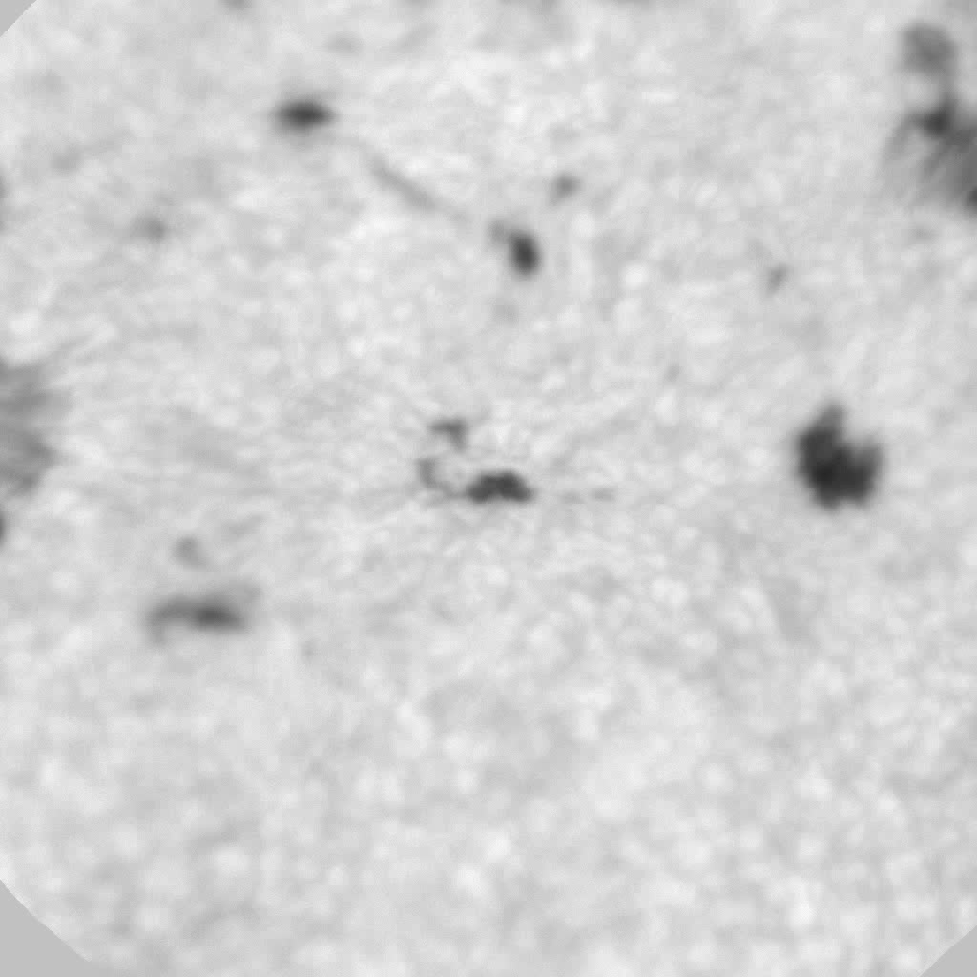
Classical AO (left) vs MCAO (right)
Notes:
Classical, single DM AO-308 vs MCAO – second DM (also with 308 subpertures) conjugated to 7 km (FOV about 85”x85”). The movies are within a two minute interval. Eye tells you that isoplanatic patch is larger in the MCAO panel. However, the “flying shadows” are compelling that the MCAO is working. The ‘flying shadows” result from the changing shape of the high altitude DM. There are 19 guide regions. 200 modes for on-axis DM and about 40 for DM conjugated to 7 km. The first DM uses an on-axis WFS, which is the whole story for AO-308. The 7km DM is followed by a downstream multi-directional WFS with 19 guide regions.
The NST MCAO setup is unique in allowing us all possible permutations in the the location of DMs and WFSs to optimized the system.

Slide 2
Notes:
The quantity shown is the residual error (the one seen by the multi-directional -WFS) that was reconstructed by KAOS during closed loop for the DM conjugated to 7 km.
This is the actual quantity KAOS controls. The plot shows the average (RMS) over about 7.25 seconds (10000 loop cycles). Both recordings were separated by about a minute as indicated in the caption.
When MCAO (i.e. Pupil + 7 km) was active, 40 modes were controlled on DM7km, the effect of which you can clearly see in the plots.
The first mode index that is plotted is not tip-tilt, but corresponds to a parabola mode. If that DM would be in a pupil, I would call it focus, but since it is not in the pupil, a parabolic shape does not end up in a "normal" defocus, but in a change of plate scale along with asymmetric off-axis aberrations. Tip-tilt is of not controlled by any DM, because that's the duty of the tip-tilt mirror.

